Slide 1
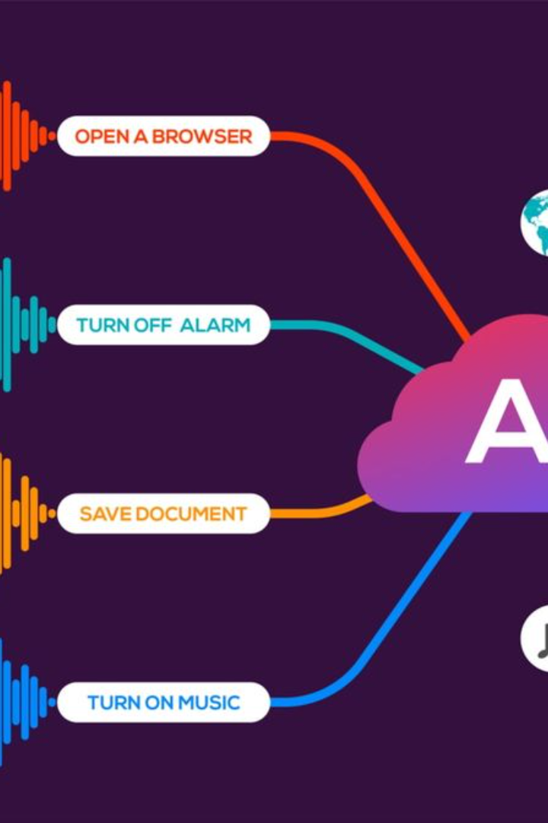
Introduction to Emotion Speech Recognition (SER)
Emotion Speech Recognition (SER) is an innovative technology that involves the use of machine learning to recognize and interpret human emotions from speech. It has applications in various fields, including customer service, healthcare, and entertainment.
Developed By
Adnan Naeem
Ali Raza Khan

Slide 2
The Significance of the MLP Model in Emotion Recognition
Emotion recognition is a crucial task in various domains including human-computer interaction, sentiment analysis, and customer feedback analysis. The MLP model, a sophisticated neural network architecture, has been specifically designed to tackle the challenges associated with emotion recognition in speech data.

Slide 3
Overview of Machine Learning in SER
Wide Application
Complex Algorithms
Technological Advancements
Machine learning plays a crucial role in SER, enabling the identification and classification of different emotional states in verbal communication.
Various machine learning algorithms are employed in SER, such as MLP, to enhance the accuracy and efficacy of emotion recognition.
Recent advancements in machine learning have opened new frontiers in SER, yielding improved emotional understanding and response comprehension.

Slide 4

Dataset Overview
24 Actors
Different Emotions
The dataset contains recordings from 24 different actors.
Each actor file includes recordings of various emotions in speech.
Emotions of Speech
Observed Emotion
Neutral
Calm
Calm
Happy
Happy
Fearful
Sad
Angry
Fearful
Disgust
Surprised

Slide 5
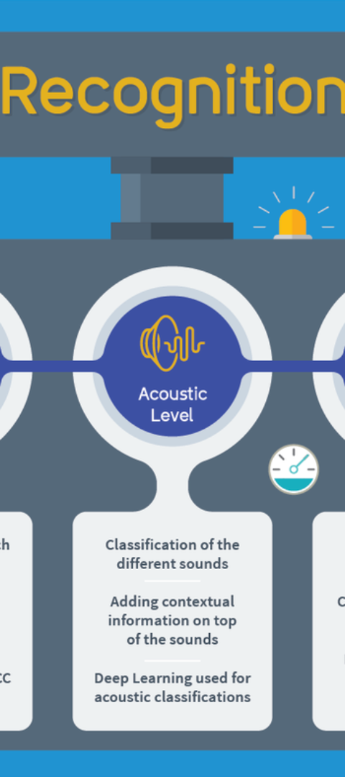


Training Data Collection and Preprocessing for SER
Data Collection
Quality and diverse data collection from multiple sources to ensure representation of various speech patterns and emotions.
Data Preprocessing
Cleansing and feature extraction are essential preprocessing steps to optimize data for SER model training.

Slide 6
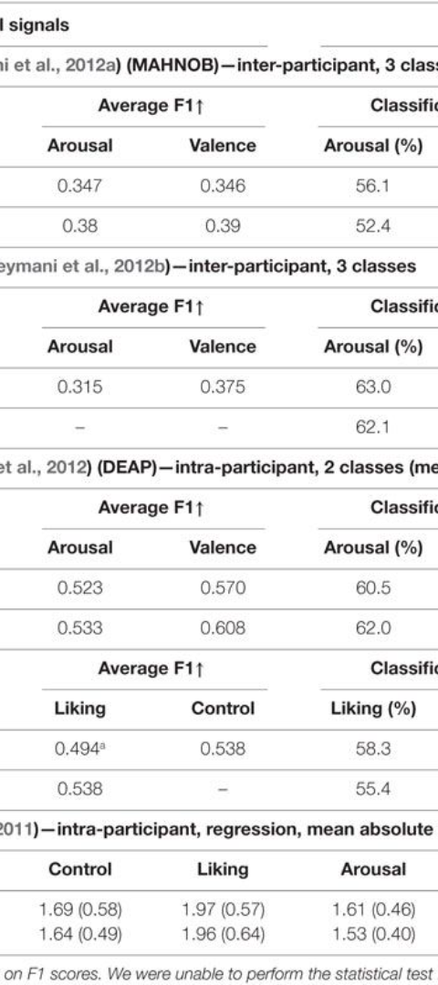
Feature Extraction Techniques for SER
Mel-Frequency Cepstral Coefficients
Chroma Features
Describe the harmonic content of an audio signal, commonly used in speech analysis tasks.
MFCC, a popular feature extraction technique, captures speech characteristics relevant to emotional content, aiding in emotion recognition.
Mel Spectrogram
Represents the frequency content of an audio signal in a way that aligns with human auditory perception. It is often used for visualization and feature extraction in speech and audio processing tasks

Slide 7
Explanation of MLP Algorithm/Model
Neural Network Model
Hidden Layers
The MLP, a feedforward neural network, is widely used due to its ability to learn complex patterns and relationships in emotional speech data.
Multiple hidden layers enable the MLP to extract hierarchical features, making it suitable for recognizing subtle emotional cues in speech.

Slide 8
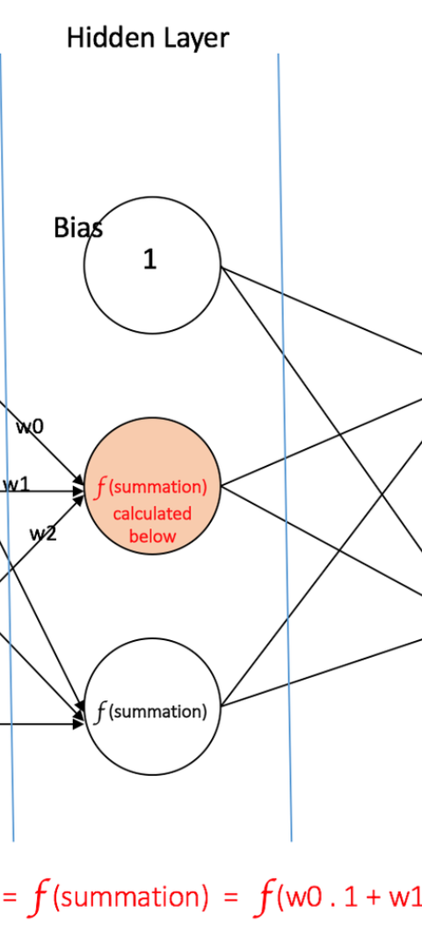
Training and Fine-Tuning the MLP Model for SER
1
Initial Model Training
Training the MLP model on labeled emotional speech data to optimize the neural network parameters for emotion recognition.
2
Hyperparameter Tuning
Refinement of the model by adjusting hyperparameters to enhance model performance and minimize overfitting or underfitting.

Slide 9
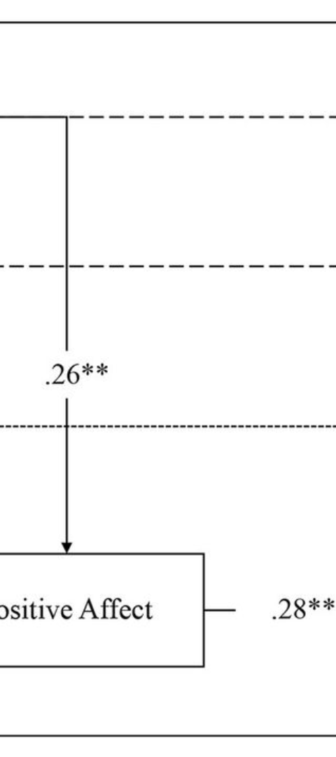
Evaluation Metrics for SER Performance
1
Accuracy and Precision
2
Confusion Matrix Analysis
Measures of classification accuracy and precision to gauge the MLP model's ability to correctly recognize emotions in speech.
A comprehensive evaluation tool to visualize the performance of the MLP model across different emotion classes in speech datasets.
3
F1 Score and ROC Curves
Quantitative measures such as F1 score and ROC curves provide robust analysis of the MLP model's overall performance in emotion recognition.

Slide 10
Conclusion and Future Directions for SER Research
Advancements in SER
Expanding Data Diversity
Human-Machine Interaction
Continued research and developments are expected to enhance emotional speech recognition accuracy and enable real-time applications across diverse domains.
Future directions focus on incorporating diverse linguistic and cultural contexts to broaden the scope of emotional speech recognition technology.
Exploration of human-machine interaction paradigms to improve emotional understanding and responsiveness in AI systems powered by SER.

